Slide 1

Power Consumption Monitoring using Home Automation
Group No. 5
Anish Salgia(16202005)
Bhavana Gupta(15102047)
Siddhesh Dalvi(15102070)
Daisy Maniar(16202011)
Project Guide and Coguide
Prof P.P.Adivarekar

Slide 2
Contents
Abstract
Introduction
Objectives
Litrature Review
Problem Definition
Existing System Architecture/Working
Proposed System Architecture/Working
Conclusion
References
Publication

Slide 3
ABSTRACT
The project describes the design and development of a system for household appliance control using cell phone through global system for mobile communication (GSM) technology. The cellular communications is a potential solution for such remote controlling activities.
SMS (short message service) technology can be used to control household appliances from distance. Remotely, the system allows the home owner to monitor and control the home appliances via mobile phone set by sending commands in the form of SMS messages and receiving the appliances status as well.
The proposed system makes use of wireless control hence can be effectively used in systems were unwired connections are desired. The system uses the user’s mobile handset for control and therefore the system is more adaptable and cost-effective and also providing ubiquitous access for appliance control.

Slide 4
INTRODUCTION
The objective of this project is to develop a device that allows the user to remotely control and monitor multiple home appliances using a cellular phone. This system will be a powerful and flexible tool that will offer this service at any time and from anywhere with the constraints of the technologies being applied.
We will be using this concept to design a system that acts as a platform to receive messages which in fact are commands sent to control different appliances and devices connected.

Slide 5
OBJECTIVE
The goals of this project are to monitor power usage in homes So, a main objective of the home energy system would be monitor power usage. If the system is going to consume more energy than it saves, then the system would be simply useless and ineffective. We will create multiple modules for switching power on and off as well as monitoring current. Also a small control unit will be built connected to a touch screen display, which will be the user interface for the system. Also, a unit which the user can monitor the usage will be designed. The central unit needs to be user friendly and safe to use. The main idea is that with this system, the user will be able to see significant power bill reductions in a simple, nearly completely passive manner.

Slide 6
LITERATURE REVIEW
We referred/went through a number of papers,mostly all were implemented using communication technology(GSM) as the main technology .Whereas some also used internet and speech recognition techniques also. All focused on functionality of GSM protocol and serial communication & AT commands for development.We also reviewed a paper of IR Remote Controller that used Ir as to interact with the devices .A system controlled by the cell phone completely through GSM was also accessed. Remotely the system allowed the system owner to control and monitor the appliances via users cell phone.

Slide 7
PROBLEM STATEMENT
The problem statement is to build a system through which the user not only can interact with the appliances remotely but also can get the status of the appliances through report generation.

Slide 8
EXISTING SYSTEM
The existing system was designed for secured wireless communication, our system is based on the WSN system user can access the system from android mobile using GSM module .Project contain the two section one is transmitter section and another section is receiver. Transmitter section is contain the android mobile and Receiver section is the actual controlling electronic system for home automation which is designed using the Arduino circuit containing the GSM module for wireless communication

Slide 9
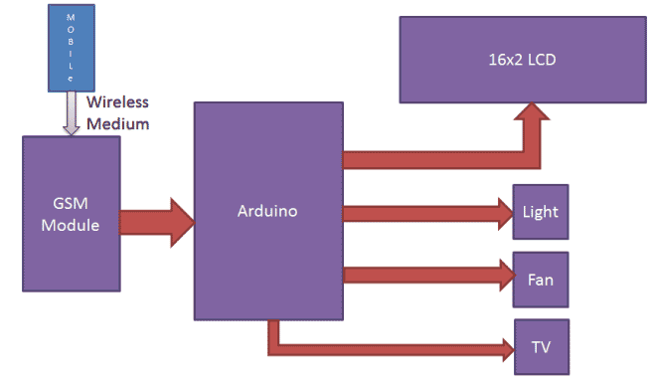
ARCHITECTURE/WORKING

Slide 10
PROPOSED SYSTEM
The proposed system will be able to control all the appliances in a controlled environment .Controlling the appliances(turning on and off respectively)can be done by the user itself.
Firstly the mobile Application will send the commands instructed by the user to the Arduino Uno module.
From there it will be forwarded to a set of relays and finally the relays will send the sensed signal to the respected appliance(Non IR).
The relays will be connected to a feedback kit,which will revert the status of the relays to the Arduino.
In addition to this, the system will also notify the user about the status of the appliances through notification.
The data about the appliances(i.e time of switching on and off,power consumed by a particular appliance)will also get generated and the user can access this data at any point of time.

Slide 11
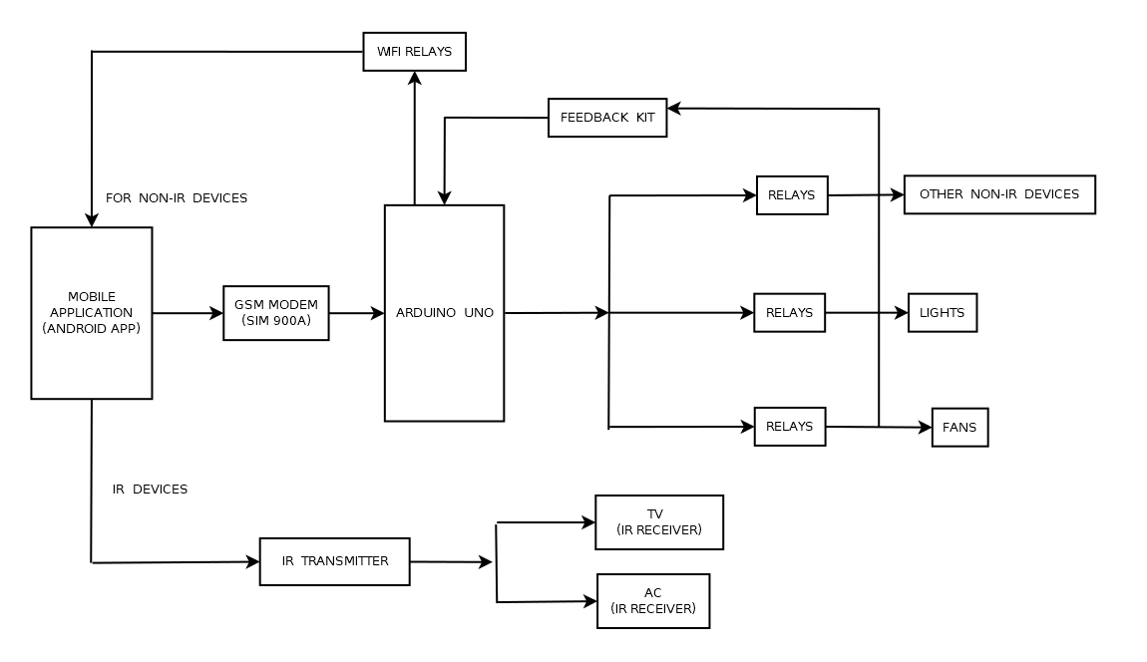
ARCHITECTURE/WORKING

Slide 12
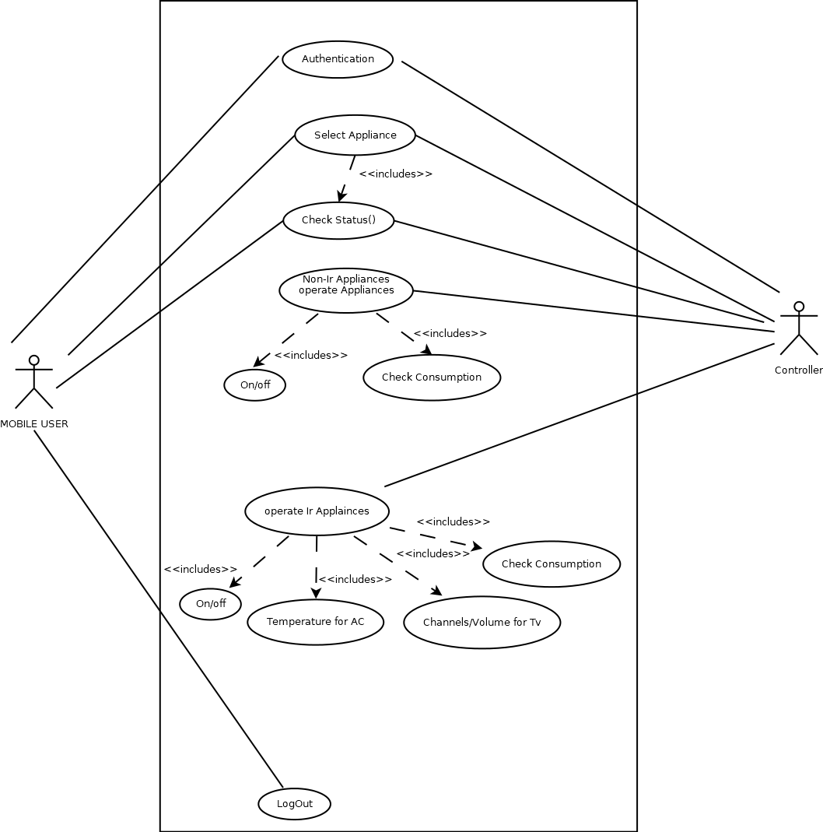
USE CASE DIAGRAM

Slide 13
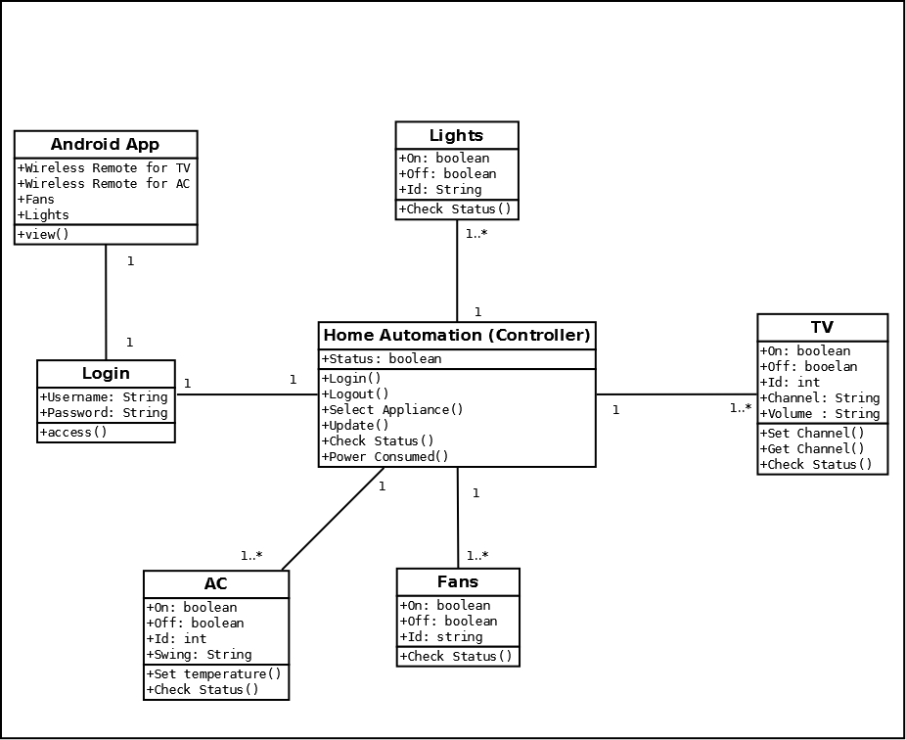
CLASS DIAGRAM

Slide 14
CONCLUSION
As the main objective of this project is to promote energy-conscious minds,the Smart Home System allows for users to keep track of energy usage at each outlet at any given time. This feature encourages the user to keep track of power consumption based on each device plugged into a power outlet, allowing one to determine whether a particular device is consuming too much power and should be replaced with a more efficient one, such as an energy star product. The feature of being able to remotely control power outlets and lights may also give the user an ultimate sense of convenience as well.

Slide 15
REFERENCES
Baris Yuksekkaya, A. Alper Kayalar, M. Bilgehan Tosun, M. Kaan Ozcan, and Ali Ziya Alkar,”A GSM, Internet and Speech Controlled Wireless Interactive Home Automation System ”IEEE Transactions,2006
Trio Adiono, Bryan Tandiawan, Syifaul Fuada, Rahmat Muttaqin, Maulana Yusuf Fathany, Waskita Adijarto,Suksmandhira Harimurti, “Prototyping Design of IR Remote Controller for Smart Home Applications”, 2017 IEEE Region 10 Conference (TENCON), Malaysia, November 5-8, 2017
Majd Ghareeb, Ahmad Farhat, Ali Oleik, Ali Bazzi, Zaher Merhi, Samih AbdulNabi ,”Smart Electrical Appliances Controller using SMS”,IEEE International Conference on Power, Control, Signals and Instrumentation Engineering (ICPCSI-2017)

Slide 16
Thank You...!!

